Slide 1
Rfi at Arecibo
2015 NanoGrav meeting
Phil Perillat

Slide 2
Talk Outline
Lband rfi
Radars old and new
zaplists
Sband rfi
Evolution of rfi over time.
Talk online at
http://www.naic.edu/~phil/talks/talks.html →feb15 nanograv
AO rfi info:
http://www.naic.edu/~phil/rfi/rfi.html

Slide 3
Lband radars seen by AO
Radar | Info
FAA radar | Old 1330,1350 – no blanking New: 4 freq. blanks 4 degs in AO direction
Punta Borinquen radar | Old : 1270 or 1290 New: 4 Freq Blanks 4 degs in AO direction
Punta Salinas radar | Frequency agile radar 18 freq Max. 4 freq In ModeA blanks 22 deg in AO direction
Aerostat radar balloon | 1246,1261 line of site to dish makes it extremely strong. They blank +/-21 degrees in AO direction

Slide 4
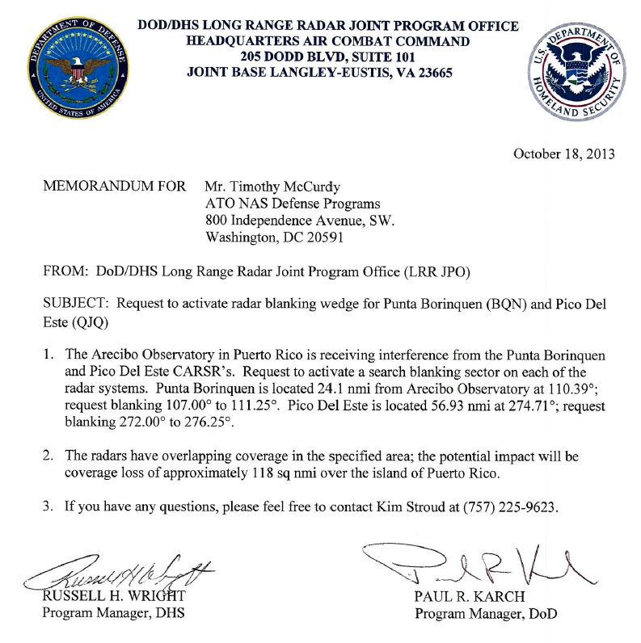
Radar changes/problems
Radar | Freq | Bandwd | Duty cycle | Sector Blanking | Dist nmi
Old FAA | 1330,1350 | .2 Mhz | .5% | no | 57
CARSR FAA | 1252.4,1257.6 1344.4,1349.6 | 1 Mhz chirped | 9% | Yes (01nov14) +/-2 deg | 57
Old Punta Borinquen | 1270 or 1290 | .2 Mhz | .5% | no | 24
CARSR PuntaBor. | 1269.4,1274.6 1327.4,1332.6 | 1 Mhz Chirped | 9% | Yes (01oct13) +/- 2 deg | 24
The FAA and PuntaBorinqen radars were replaced by CARSR (Common Air Route Surveillance Radar)
Punta Borinquen upgraded: Apr 2013
FAA upgraded: Aug 2013
Run by FAA but only used by DOD,DHS.
They are blanking the radars +/- 2 degrees toward AO. Memo:
The Aerostat radar was off the air Dec 2011 to Aug 2014 ( the support cable broke, balloon crashed)..
We have an MOU with punta Salinas. They will only use 4 freq (ModeA) when AO uses lband. At other time they will use up to 18 channels. For July/Aug 2014 they didn’t do this

Slide 5
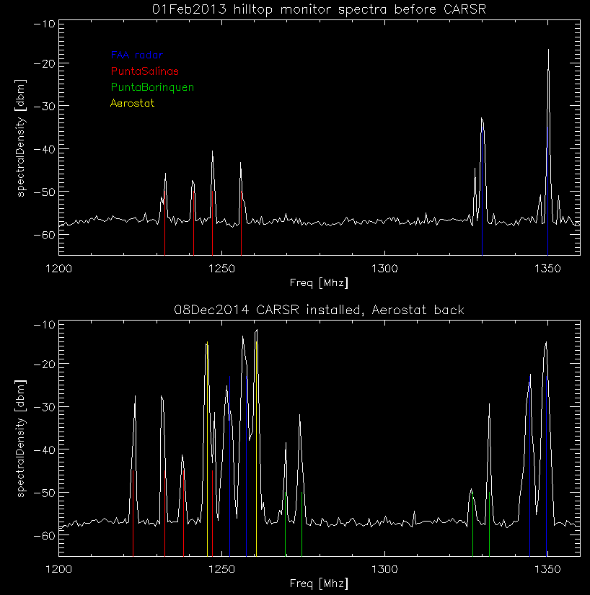
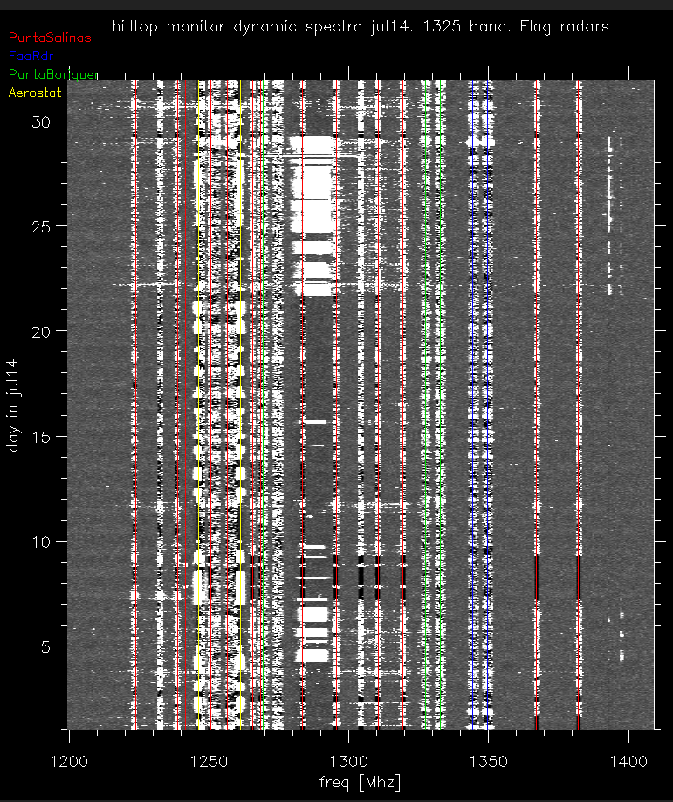
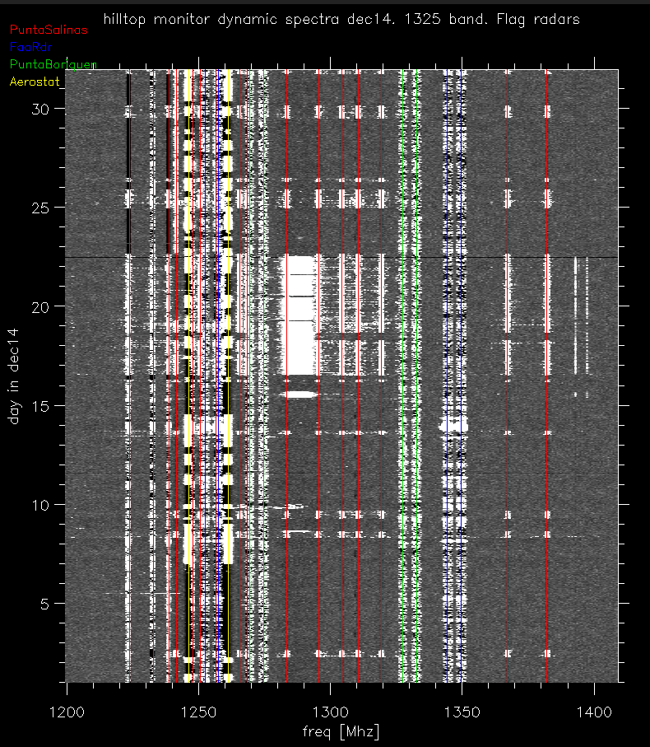
Hilltop rfi monitoring
1 min. peak hold spectra.. Spectrum analyzer on hilltop.
Top: Dec2013: no CARSR, No aerostat
Bottom: Dec:2014 CARSR and aerostat
Dynamic spectra July 2014.
Shows punta Salinas not staying in modeA
Lasted for july and aug 2014. they had trouble with their radar.
Dynamic spectra Dec 2014.
Shows punta Salinas going to modeA (when ao is using lband)

Slide 6
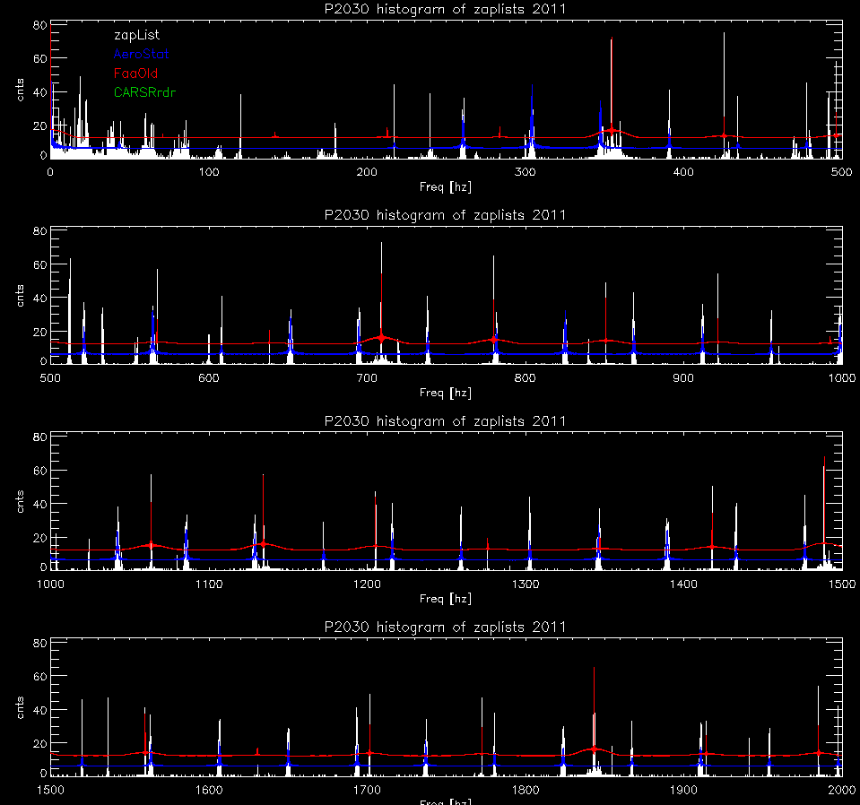
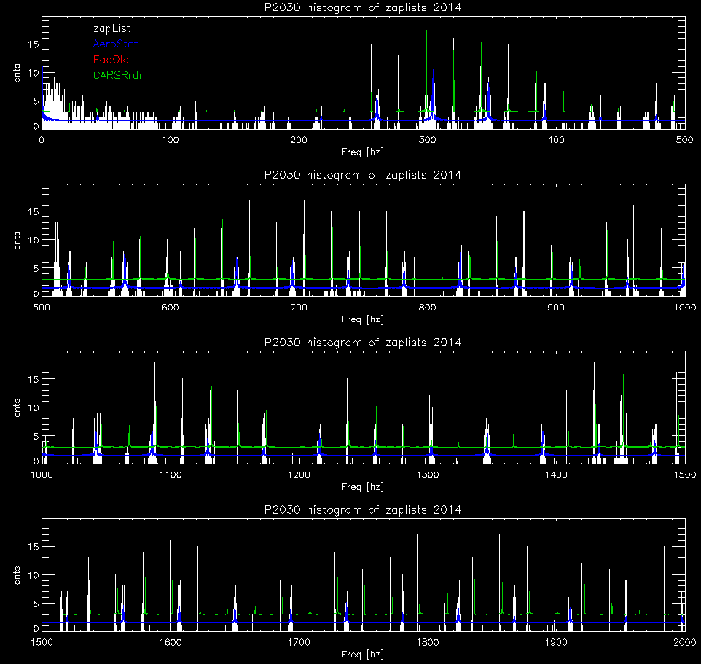
Pulsar search zaplists
Vicki and Patrick provided me with the zaplists from the palfa search. The lists count the number of times interfering periodicities appear in the pulsar search analysis (by day).
I modelled the periods that the various radars should create and then overlaid them on plots of the zaplists.
The first set shows 2011 (before the CARSR)
The 2nd set is jan-jun 2014 (with the CARSR)
Note: The zaplists also helped us find a problem in the bias monitoring of alfa. It was generating 20ms periods.

Slide 7
Sband rfi
Sband wide receiver covers 1700-3100 Mhz
Rf filter bank selects bands:
1700-1880, 2040-2400,2600-3100 Mhz
Sources of Rfi in this band:
Freq range | Description
1710-1755 (mobile) 2110-2155 (base station) | Advanced Wireless Services (AWS-1)
1850-1910 1930-1990 | Broadband PCS (cell phones)
2305-2320 2345-2360 | Wireless Comm. Services (WCS)
2320-2332 2332-2345 | Satellite radio:Sirius/xms
2400-2500 | Ism. Unregulated Wifi, internet Providers

Slide 8
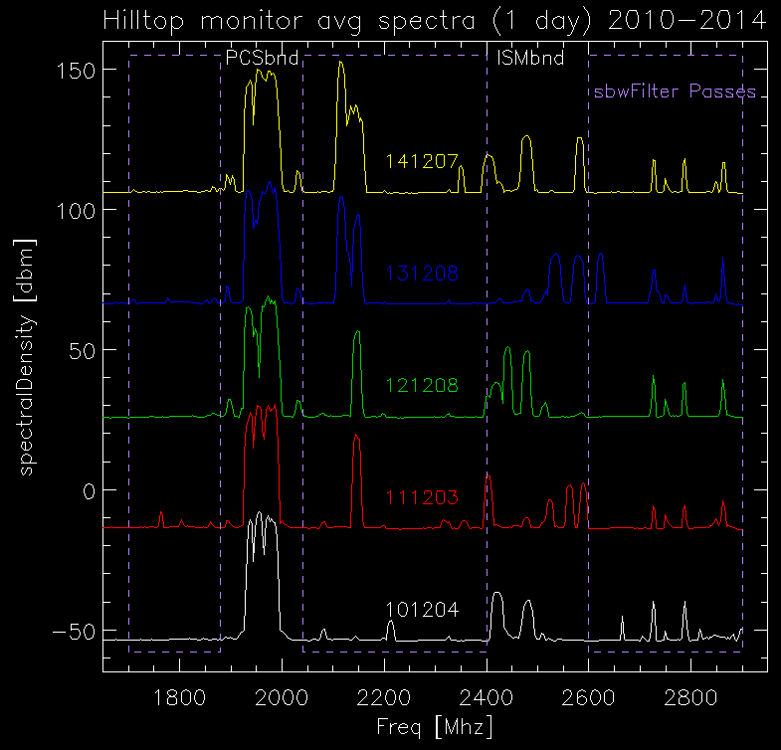
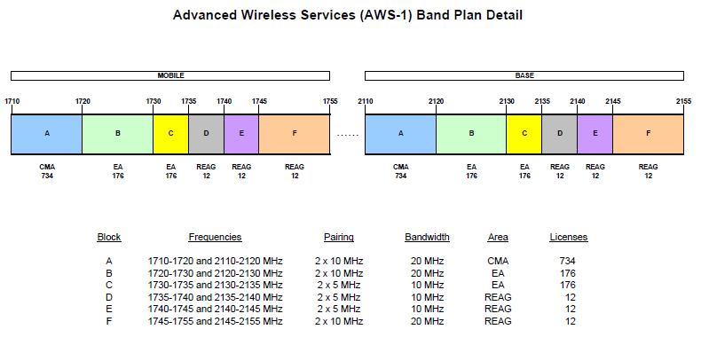
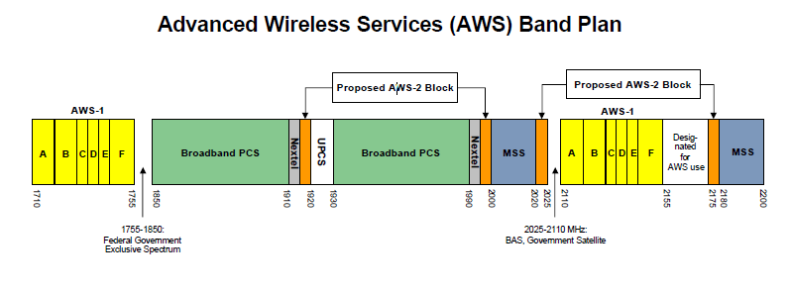
Sband:hilltop monitor plots
Plots show the average spectra for 1 day
Dec: 2010,2011,2012,2013,2014
This is only a single day so rfi can change.
A more detailed look at AWS plan.
The digital radio (2320-2330) shows up stronger in sbw than the hilltop monitor data (the monitor looks at the horizon).

Slide 9
Summary
The FAA and PuntaBorinquen radars were upgraded to CARSR radars apr-aug 2013
Using more frequencies, creating more periodicities, but now blanking toward AO.
The PuntaSalinas radar was not moving to modeA while AO used lband jul-aug2014
A new commander is being appointed. We need to have a get together.
The AWS-1 signals get through the sbw filterbank.
Probably causing harmonics/intermods in puppi…

