Slide 1
RFI issues at AO
2015 AOUC committee
Phil Perillat

Slide 2
Talk Outline
Lband radars
Sband rfi
Online: http://www.naic.edu/~phil/talks/talks.html →apr15 aouc

Slide 3
Lband radars seen by AO
Radar | Info
FAA radar | Old 1330,1350 – no blanking New:1252.1258,1344,1350 (CARSR) blanks 4 degs in AO direction
Punta Borinquen radar | Old : 1270 or 1290 New:1269,1276,1327,1333 (CARSR) Blanks 4 degs in AO direction
Punta Salinas radar | Frequency agile radar Old:1232,1247,1242,1256 (ModeA) New:1228,1243,1279,1294 blanks 30 deg in AO direction
Aerostat radar balloon | 1246,1261 line of site to dish makes it extremely strong. They blank +/-21 degrees in AO direction

Slide 4
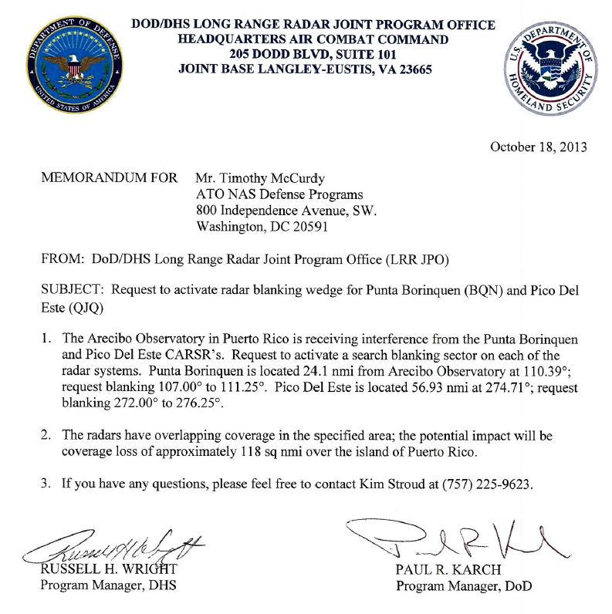
Radar changes/problems
The FAA and PuntaBorinqen radars were replaced by CARSR (Common Air Route Surveillance Radar)
Punta Borinquen upgraded: Apr 2013
FAA upgraded: Aug 2013
Run by FAA but only used by DOD,DHS.
They are blanking the radars +/- 2 degrees toward AO.
We needed a memo from DoD,DHS to get the blanking.
The Aerostat radar was off the air Dec 2011 to Apr 2014 ( the support cable broke, balloon crashed). It’s now back up.
Radar | Freq | Bandwd | Duty cycle | Sector Blanking | Dist nmi
Old FAA | 1330,1350 | .2 Mhz | .5% | no | 57
CARSR FAA | 1252.4,1257.6 1344.4,1349.6 | 1 Mhz chirped | 9% | Yes (01nov14) +/-2 deg | 57
Old Punta Borinquen | 1270 or 1290 | .2 Mhz | .5% | no | 24
CARSR PuntaBor. | 1269.4,1274.6 1327.4,1332.6 | 1 Mhz Chirped | 9% | Yes (01oct13) +/- 2 deg | 24

Slide 5
Punta Salinas radar
Punta Salinas is a freq. Agile phased array radar
Apr 15 upgrading from 18 to 100 dual freq channels.
They will no longer xmit freq close to other radars on the island
MOU: when AO uses lband, they use 2 dual freq channels (called modeA).
We’ve had some trouble with this, especially during upgrades.

Slide 6
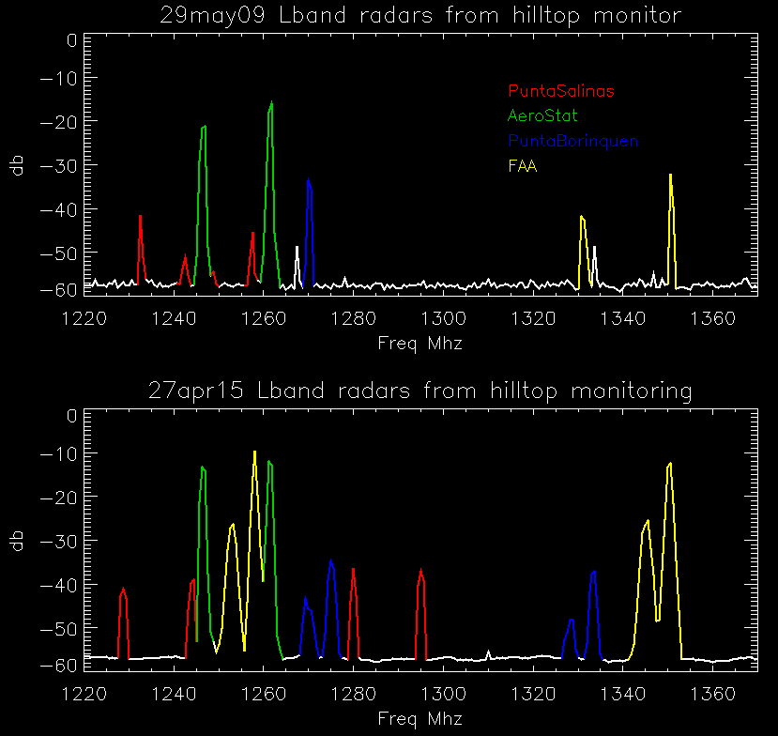
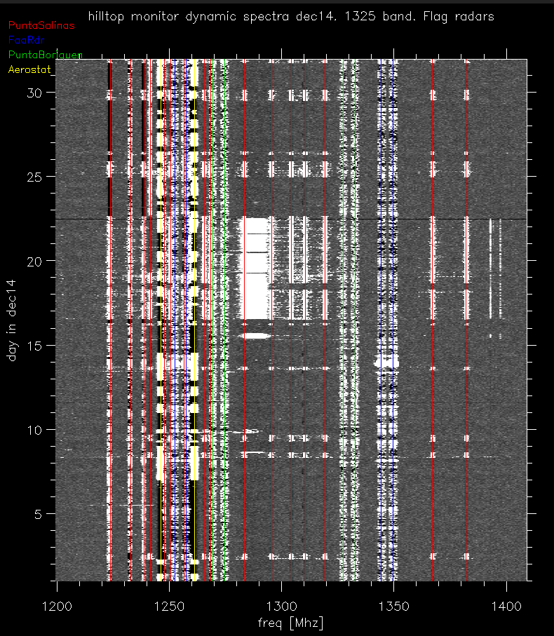
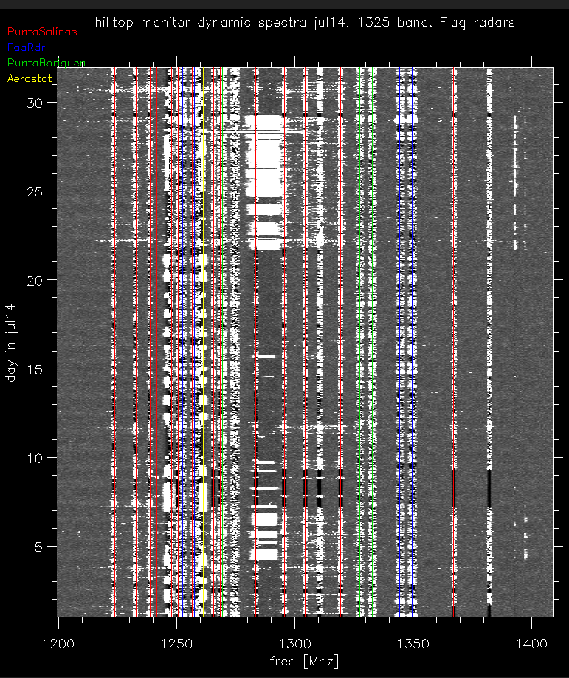
Hilltop rfi monitoring:Lband
1 min. peak hold spectra.. Spectrum analyzer on hilltop.
Compare radar frequency usage:
Top: 29may09:
Bottom:27apr15
Dynamic spectra shows Punta Salinas in modeA
Dec 2014: mode A when AO uses lband
July 2014: not going to modeA
Had trouble with their radar. Jul,Aug14

Slide 7
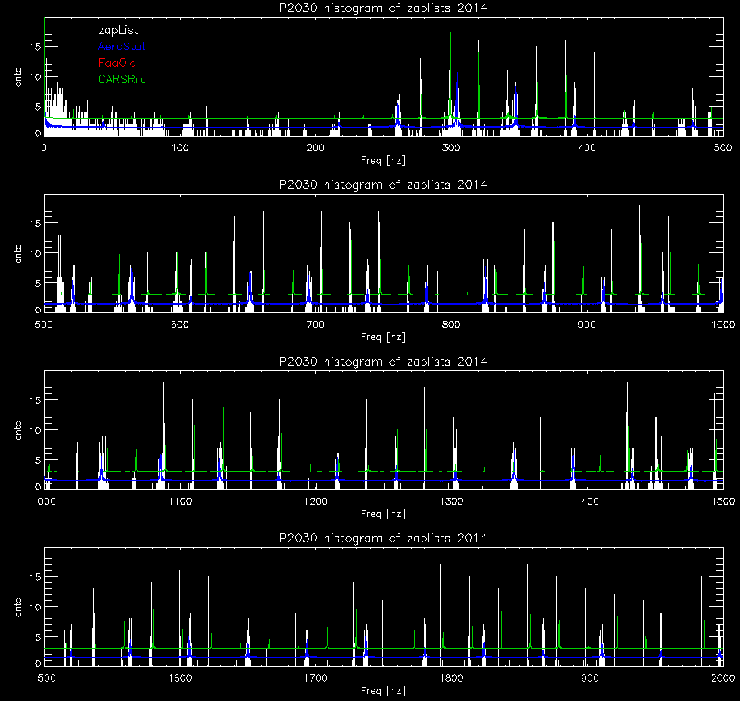
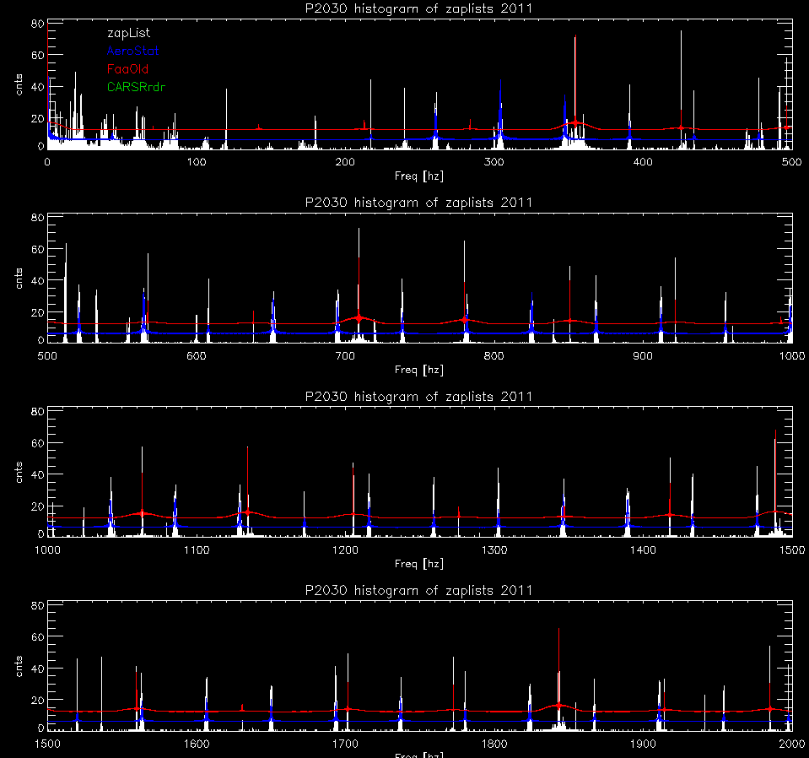
Pulsar searching with radars
Vicki and Patrick provided me with the zaplists from the palfa search. The lists count the number of times interfering periodicities appear in the pulsar search analysis (by day).
I modelled the periods that the various radars should create and then overlaid them on plots of the zaplists.
The first set shows 2011 (before the CARSR)
The 2nd set is jan-jun 2014 (with the CARSR)
Note: The zaplists also helped us find a problem in the bias monitoring of alfa. It was generating 20ms periods.

Slide 8
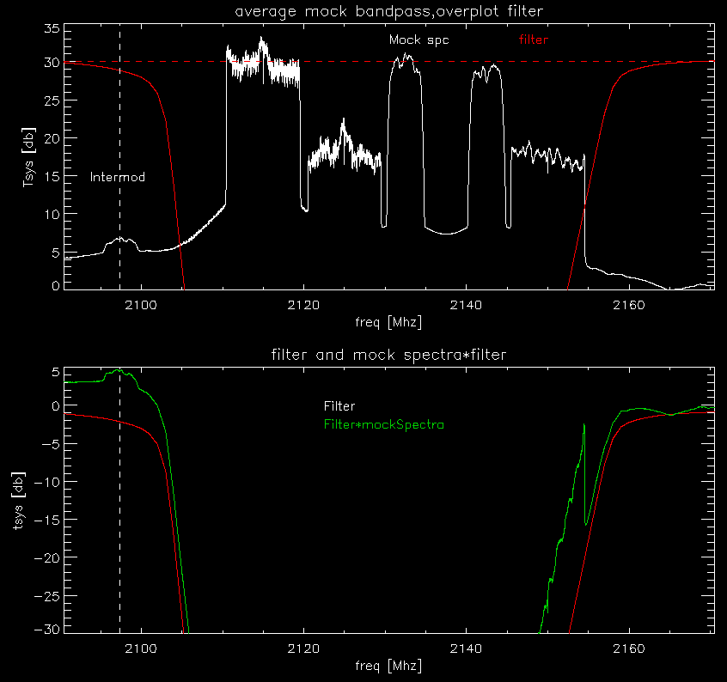
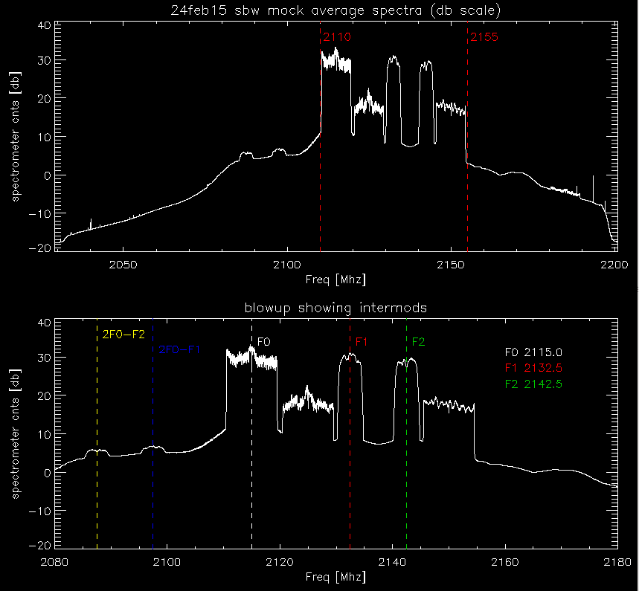
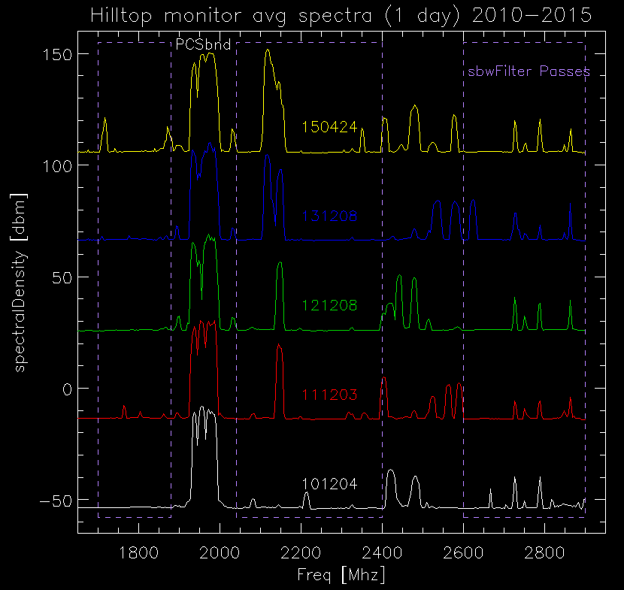
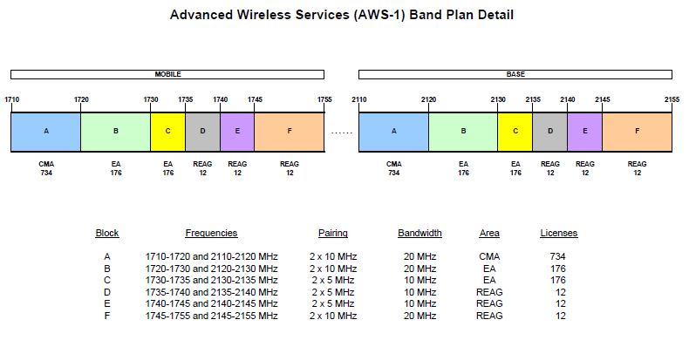
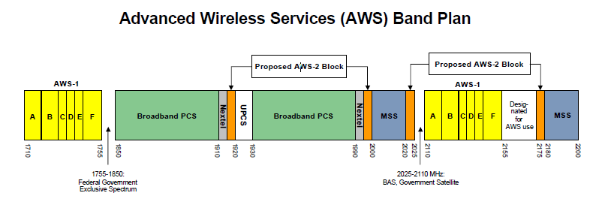
Sband rfi
Hilltop plots:average spectra for 1 day
2010,2011,2012,2013,2015
This is only a single day so rfi can change.
A more detailed look at AWS plan.
2110-2155 Mhz notched filter on order.
Sbw band showing AWS and intermods
Sbw band with projected filter overlayed
Should receive filter in a week or two.

Slide 9
Summary 1
lband radars ideas to explore with radar owners
Don’t ignore AO agreements during upgrades/repairs.
Officially contact AO ahead of upgrades
Punta Salinas. If they can’t go to modeA for any reason, could they shutdown for that period?
Radars run by:DoD,DHS,FAA
Each with a different mission. Need more sharing of data between them. They interfere with us and with each other.
When Punta Salinas and FAA point at each other, they are blinded. If one would blank, the other could distribute the data. But they don’t….

Slide 10
Summary 2
Radars run by:DoD,DHS,FAA
If better sharing of data, could we reduce the number of radars??? (and save the gov $ running so many).
This would require meetings at a higher level
AO blanker:
Looking into feasibility of blanking some of these radars. At first look seems hard.
CARSR’s drop 5 ipps every about 300 secs.

Slide 11
Summary 3
Sband rfi
Get notched filter installed.
Questions?

