Slide 1
Telescope and Datataking status
2012 Visiting Committee Meeting
Phil Perillat

Slide 2
Talk Outline
Time line of some events affecting performance.
Pointing:
Beam repair required new model.
Gain,Tsys,SEFD of various receivers.
What the gain vs frequency says about the surface error.
Issues:
Platform, dome weight, tertiary drive system surveying optics
Tiedown system, distomat equipment hard to maintain.
Datataking status:
Summary
Online: http://www.naic.edu/~phil/talks/talks.html →apr12_aouc

Slide 3
Timeline of events
Date | Event
03feb2010 | Broken beam found on platform. Limited za range.
20sep2010 | Distomat replaced. No more spares. No longer repairable.
05feb2011 | Broken beam repair complete. Telescope back to full za range.
27oct2011 | Td 4,8 computers failed. No spares
25feb2012 | Special order td computers, i/o boards received (>20 cpus, a/d boards. Lacking some digital i/o boards). Tiedowns back online.
28feb2012 | Data taken for new pointing model

Slide 4
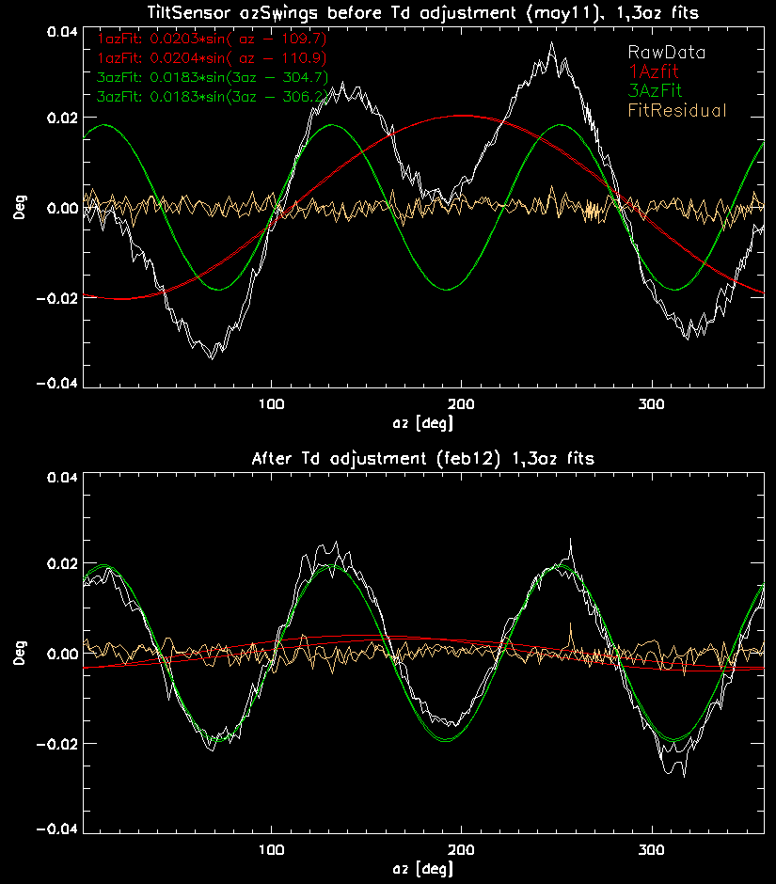
Pointing:Platform tilt
Source of platform Tilt:
Tilt from ch,dome weight imbalance corrected by elevation rail shimming.
Tilt from main cables, td cables, corner weight imbalances corrected by using different tensions on the 3 tiedown cables.
Tilt affects pointing and gain.
Beam repair feb10-feb11 changed platform tilt
Either weight distribution or td Tension on broken beam changed.
Correcting the corner imbalance tilt:
Az swings with tilt sensors in the dome measure the entire platform tilt. The C0*sin(az-ph) fit to azswing tilt measures the residual tilt from corner imbalances

Slide 5
Pointing :model
Date | Az Err (arcsec) | Za Err (arcsec) | Total Err (arcsec)
2003 mod14 | 5.38 | 3.48 | 6.41
2004 mod15 | 4.20 | 2.41 | 4.84
2007mod17 | 4.39 | 2.99 | 5.31
Jul08-feb09 | 6.8 | 4.6 | 8.2
Mar09-jan10 | 6.3 | 4.9 | 8.0
Mar10-> | 10.6 | 9.0 | 13.9
Feb12mod18 | 4.18 | 2.13 | 4.69
Data taken 28feb12 – 04mar12 with new tiedown positions
Wanted to make the model in the winter so there would be less chance of rain (rain causes distomats to not work).
Had to wait for the tiedown replacement parts to be installed.
Feb11 – Feb 12: Platform tilt pntErr partially corrected by updating 1az term of model. Needed new td position to correct error and gain loss (needed new model to do this).
Model not yet installed.
Need to transfer the offsets to the other 12 feeds. Needs about 3 nights of observing (with no rain!). Alfa coming down delayed this. Now scheduled for may12.

Slide 6
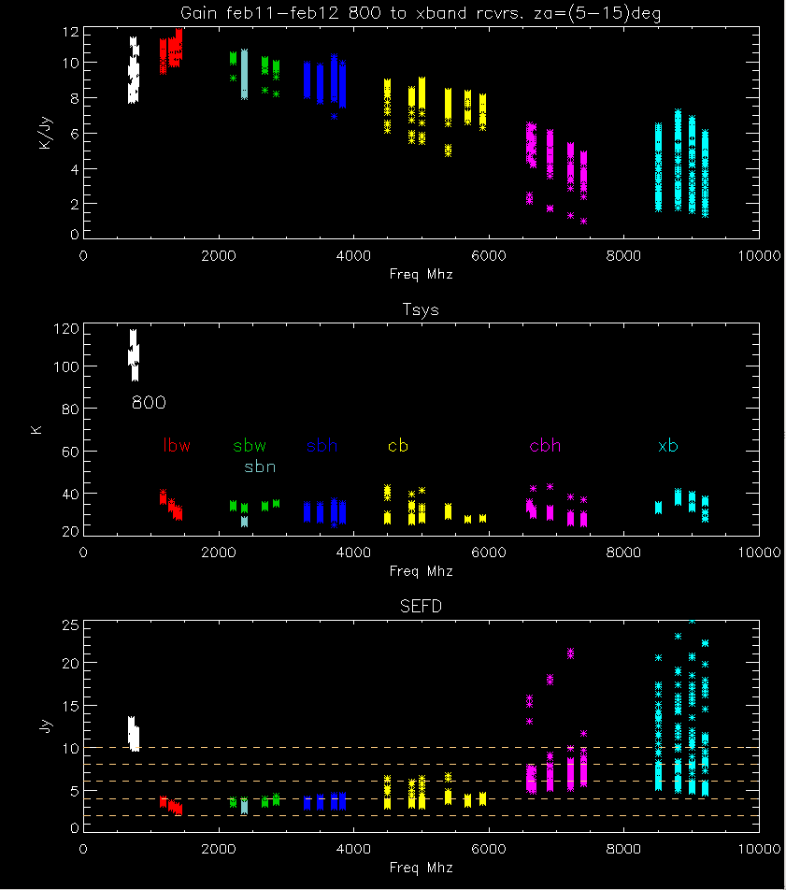
Gain,Tsys,SEFD
Data from feb11-feb12
Limit za range 5-15 degrees
Plot shows gain,Tsys,SEFD vs freq.
Color by receiver
SEFD lines spaced every 2 Jy.
Data spread within each freq band:
Some calibrators better fluxes than others (gain,sefd).
High freq: pitch, roll, focus errors, Rain.
Some cal values (xband) need to be remeasured (gain,tsys)

Slide 7
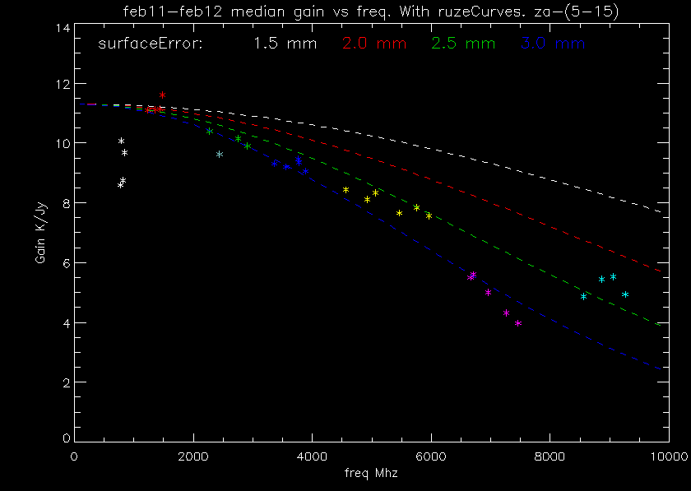
Gain vs Freq:ruze curves
Optical surface errors: Ruze formula:
$G=g0∗e^{−\left(\frac{4∗pi∗SurfErr}{lambda}\right)∗∗2}$
g0=gain at infinite wavelength (no errors).
Assumes uncorrelated errors. Collimation errors (pitch, roll, focus,..) will mix in with surface errors.
Non surface error gain variations:
collimation errors especially at high frequencies
Sbn, cbh under illuminating the tertiary lowers gain
Xband cals too low → gain too high.

Slide 8
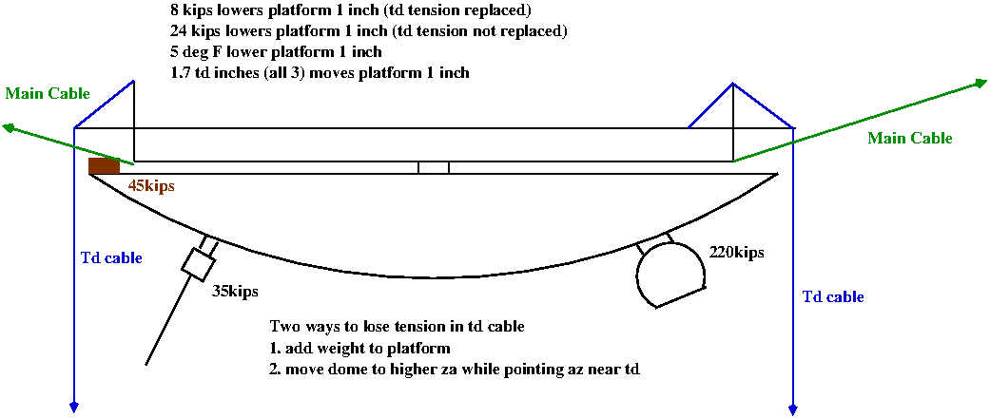
Issues:Losing td tension
Plot shows forces on platform:
Tilt from dome motion corrected by shimming the elevation rails (as long as we don’t loose tension in td cable).
Temperature lowers platform 1” every 5degF.
When az points close to tower (cos(120-az)), dome can cause tension to be lost in tiedown.
When tension lost in td, 2 things happen:
Pointing and collimation error. Feed off paraxial surface.
The td tracking algorithm tries to keep the avg height of the platform fixed. Releases tension on 3 td’s, but only 2 respond. This tilts platform even more. Problem is tension measurement not reliable.

Slide 9
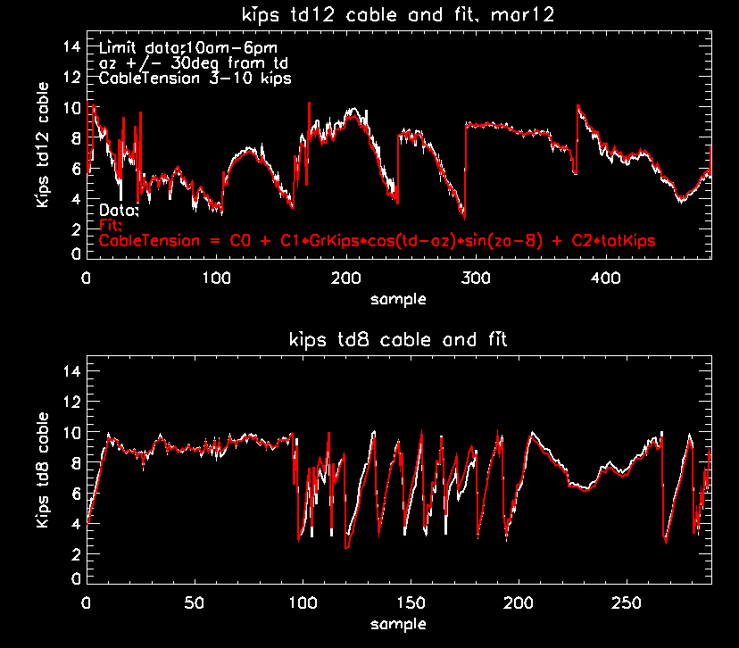
Losing td tension:Fit to data
Look at td tension data mar12.
10am-6pm. Day/nite cable/air temp differences.
Fit data with 3-10 kips then extrapolate to tension=0 kips.
Platform at correct height (1256.22 feet +/- .2”)
Az=+/-30 degrees from corner.
Fit:
$Tension=C0+C1∗grKips∗\cos\left(td−az\right)∗\sin\left(za−8\right)+C2∗totTdKips$
totTdKips: total tiedown kips needed to keep avg height of the platform in focus for the current temperature.

Slide 10
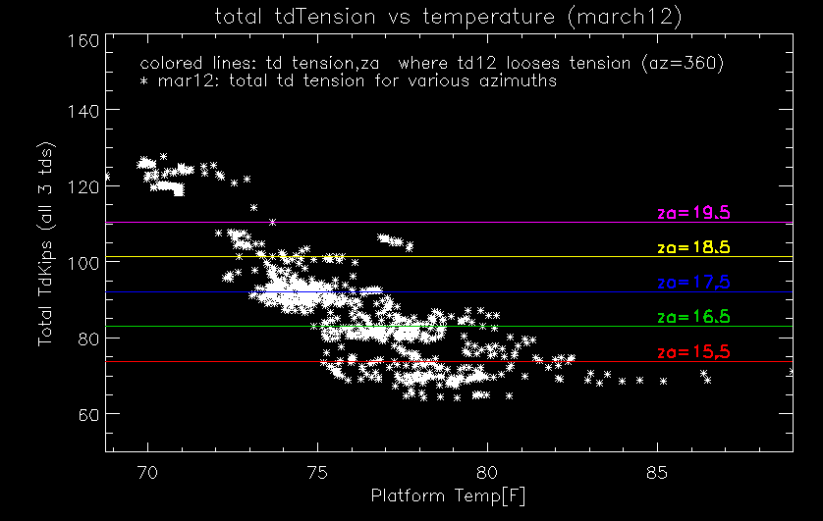
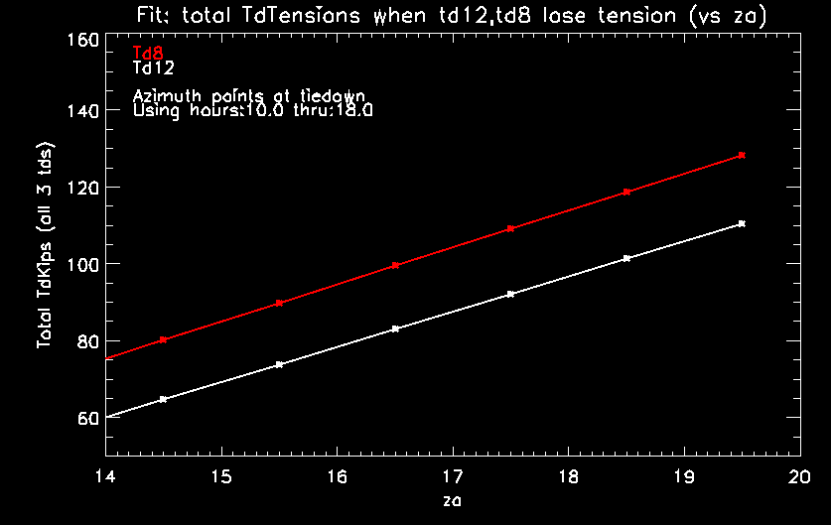
Losing td tension: when…
Using fit, plot total td tension vs za when a td loses tension (and az pointing at td)
Total tension td12,td8 differ (td12 corner heavier).
Plot total kips vs temp. Show lines where td loses tension if az pointing at td.
When platform in focus, total tdkips a function of temperature (in cable). Spread comes from difference air, cable temps.
Za=19.5 loose tension down to 72 deg F
Za=15.5 loose tension down to 75 degF
Temp sensors on cables would allow better estimate of platform height vs temp (could use when distomats fail).

Slide 11
Losing td tension: options
Raise platform by pulling on main cables.
Current safety factor 2. Unless mains have stretched, can’t pull anymore (measure mains tension?)
Mains angle is shallow so doesn’t raisen platform very fast:
Remove weight platform, dome:
Platform: 40 kips
Dome :less needed since easier to tilt platform.
Use moveable tertiary to make focal length longer.

Slide 12
Issues: tertiary drive system
Tertiary drive lets you make focal length longer.
Only lose about 30% gain (primary,secondary not corrected).
Drive system has been built 3 times:
Riccardo elias, bill sisk, hector camacho.
Each engineer has left before final implementation
Status: drive cabinet in lab, constructed.
Needs debugging, engineer to dedicate to it, ability to survey tertiary to move it along optic axis..(and to know where the optic azis is).

Slide 13
Issues: Surveying optics
Surveying optics:
Dome from AO9 to measure the shimming of elevation rails.
In dome: secondary is reference.
Locate tertiary (via paddles above it .. No longer exist).
Position new feeds to correct height and tilt.
People lost in transition:
Lynn baker wrote mathematica code to analyze survey results.
German Cortes worked on the optical paths using his aoant program.
Not sure how we plan to position wide band reciever?

Slide 14
Issues:equipment not available
Tiedowns: little star computers and i/o boards.
Lost 4 months of hi freq observing when last cpu failed.
Feb12: one time purchase $11K. Got 30 cpus, 20 a/d, d/a boards, lacking some digital i/o boards. Should last for awhile.
Problem remains: tiedown cables acting as platform ground especially during lightning…Insulators in cables?
Distomats. Not repairable since 2010. no spares.
Tried various replacements. All have rfi problems.
New system could have a trackable distomat in dome looking at targets on ground. Tells the position of dome rather than just the platform. Has it’s own problems.. Distance, xmter rfi.

Slide 15
Datataking
 | Pols | Chan | Maxbw | Bands | copies
current | 4 | 8192 | 172Mhz | 7 | 2
newMix | 4 | 8192 | 172Mhz | 7*2 | 2
Puppi pulsar processor ..In use.
800 Mhz bw, coherent dedispersion.
Mocks.
Time domain sampling. 16 bits 10Mhz 1pol=40mb/sec
4,8 bit sampling available, but mixers can’t put out enough power.
For single pixel observing only using 1/2 of the available bands.
Wideband line searches need more bands for higher resolution
Current mixers designed for alfa. Replace them with more general set.
Needed for wideband line searches at high freq resolution.

Slide 16
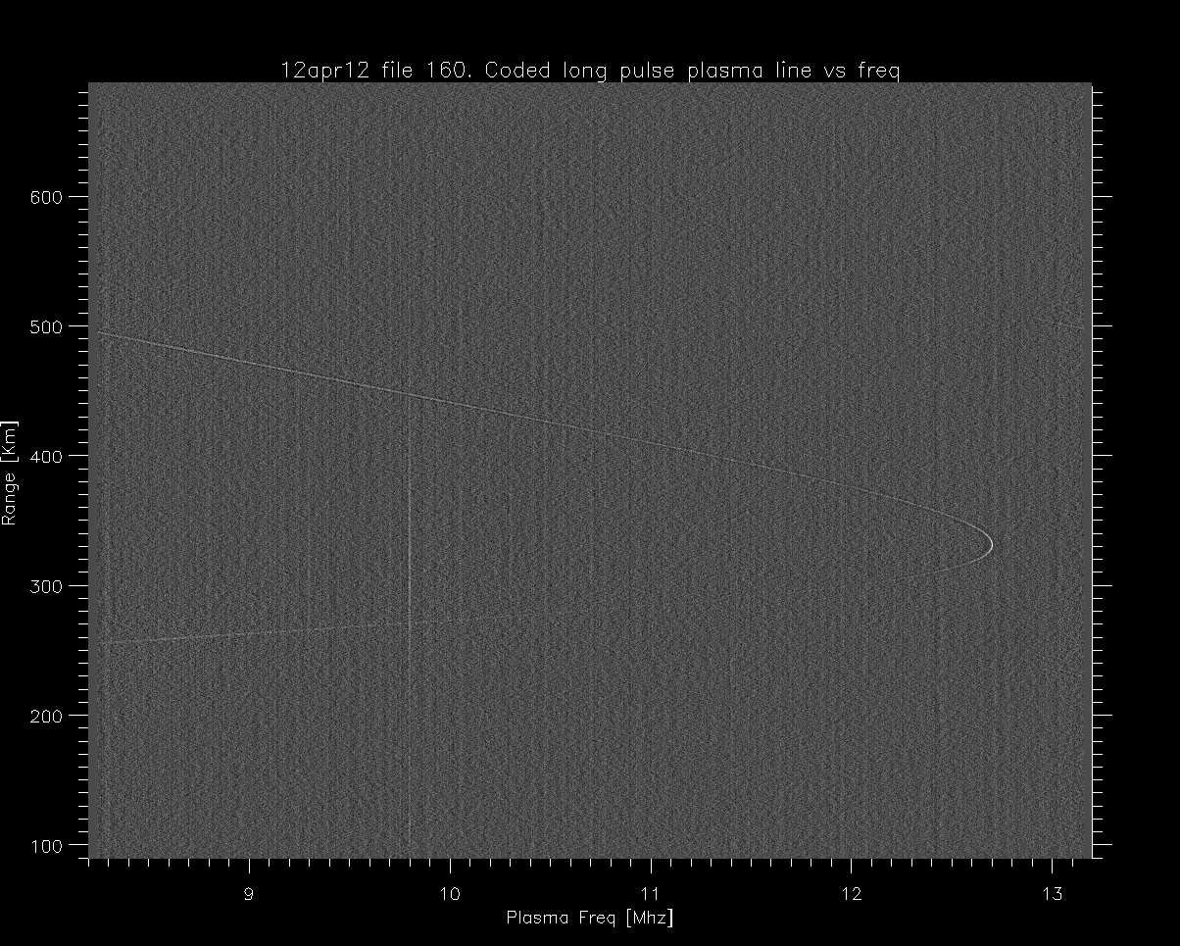
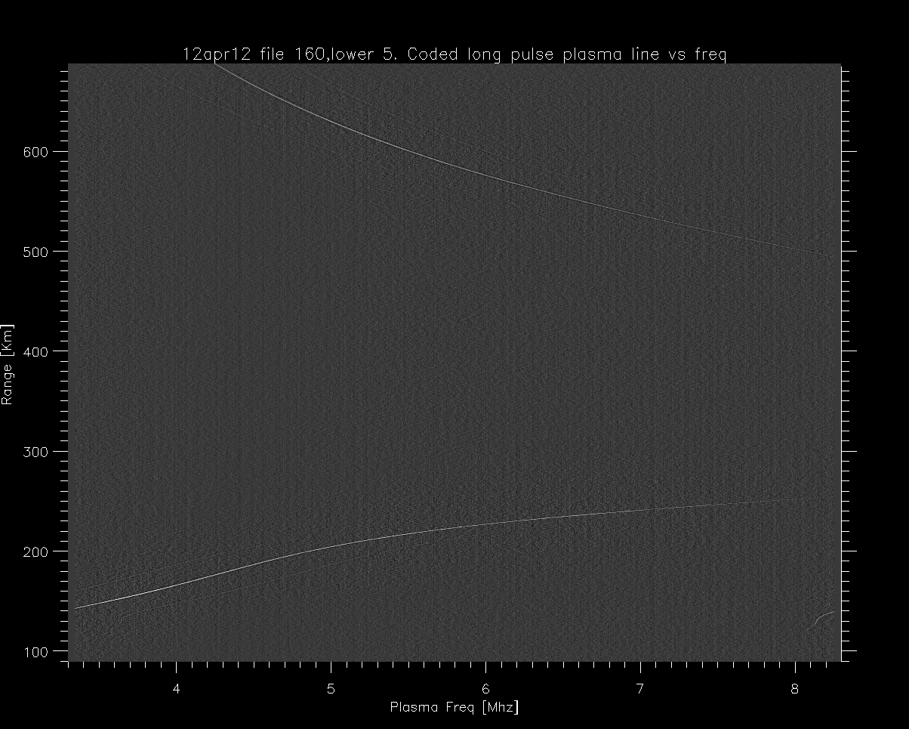
Datataking..
Aeronomy:
Need wide band (25-30Mhz) recorder.
On going project (> 2yrs) 25Mhz bw using mock box..
With solar max, plasma freq > 12 Mhz. Up and down shifted line needs >= 25 Mhz. Currently we can only get 2 5Mhz chunks.
Sband radar:
Need wide band recorder >=25 Mhz to get full bandwidth of klystron tubes. Current 20Mhz recording not reliable.
VLBI: new recorders… see ganesh’s talk…

Slide 17
Waiting to happen
12 meter telescope
Communications code written
Need to write pointing program, integrate it into system.

Slide 18
Summary
Telescope performance:
Pointing:
New model made, residuals 4.7 asecs. Needs to be installed.
Gain,Tsys,sefd,Tsys
Data from previous year had platform tilt (corrected in new model). Caused low gains at high freq.
Ruze curves show surface errors ~ 3mm. Probably not this bad.
Measured cal values not being updated (lack of personnel)
Issues:
Tiedowns losing tension, platform weight.
Installing tertiary drive system to help this.
Requires engineer.
Need to regain ability to survey the optics and analyze the data.
Td, distomat equipment needs to be replaced. Out of date.

Slide 19
Summary…
Datataking:
Puppi pulsar processor installed
mocks
Time domain sampling added
Upgrade mixers for single pixel.
Aeronomy
Get wide band recorder
Sband
Get wide band recorder.
12 meter.. Find time to implement

Slide 20
Summary..
Staffing: things are not getting done in a timely manner because of staffing levels:
Maintaining up to date cal values
Surveying and correcting the optics.
Installing the tertiary drive system
Maintaining the tiedown grounding system.
Completing aeronomy, sband recorders.
…..

